Slide 1

DEPARTMENT OF ECE
UEC1811 – PROJECT WORK
AN EFFICIENT CHANNEL CODING FOR FUTURISTIC CORDLESS APPLICATION
Domain – Very Large Scale Integration(VLSI)
GUIDED BY
Ms . RADHA N M.E,(Ph.D),
Assistant professor.
Department of ECE.
K.Ramakrishnan College Of Engineering.
TEAM MEMBERS
Muthulaxmi.M (8115U20EC061)
Pavitra.M (8115U20EC069)
Priyadharshini.S (8115U20EC072)
Rati Priya.C (8115U20EC077)

Slide 2
CONTENTS
ABSTRACT
INTRODUCTION
LITERATURE SURVEY
EXISTING SYSTEM
CHALLENGES IN EXISTING SYSTEM
PROPOSED SYSTEM
SOFTWARE REQUIREMENTS
MODULE DESCRIPTION
CONCLUSION
FUTURE SCOPE
REFERENCES
2

Slide 3
ABSTRACT
Channel coding is the process of adding redundant bits with the original information bits so as to improve the reliability of the data transmission. It is a cornerstone in modern communication systems, especially in wireless applications, where data transmission is susceptible to various impairments such as noise and interference.
In wireless transmission, high power consumption, larger area consumption, and minimal speed are the major challenges in channel coding. The Bit Error Rate should also be reduced during transmission over noisy channel.
This work proposes a novel channel coding scheme (Minimal intricacy parity check code) that reduces the Bit Error Rate for reliable data communication while also ensuring efficient power consumption , area consumption and delay.

Slide 4
LITERATURE SURVEY
S.No | Paper Title (With Citation) | Methodology | Advantages | Disadvantages
1 | Paterson K.G and Jones A.E 2000 Efficient decoding algorithms for generalized Reed-Muller codes. IEEE Transactions on Communications, 48(8), pp.1272-1285. | Reed-Muller codes are constructed based on Boolean functions and are characterized by their order (r) and dimension (m). Determine the type and distribution of errors expected in the system, such as random errors, burst errors, or specific channel characteristics. | Efficient decoding algorithms enable correction of errors with a success rate of approximately 95% MLD algorithm for Reed-Muller codes has computational complexity reduced by approximately 70% | Exponential increase in computational resources required, limiting practical applications by approximately 80%. 2) Challenge in balancing performance, particularly impacting applications by approximately 70%.
2 | Zhong H and Zhang T 2005 Block-LDPC: A practical LDPC coding system design approach. IEEE Transactions on Circuits and Systems I: Regular Papers, 52(4), pp.766-775. | 1)The method used for implementation of LDPC code is Bloom Filtering which is the fast and efficient way to check whether a given element is belongs to a set. It detect and correct errors in their associated data set. 2)This method can be used in practical designs to effectively mitigate errors with reduced overhead. | Optimizes data transmission and storage by approximately 85%. Improves data retrieval efficiency by approximately 75%. | Additional overhead increases by approximately 70%. Probability of false positives introduces uncertainty by approximately 65%.
2/12/2024
6
Notes:
SLIDE NO:01

Slide 5
CONT..
S.No | Paper Title (With Citation) | Methodology | Advantages | Disadvantages
3 | S. M. Elengical, F. Takawira and H. Xu, &quot;Reduced complexity maximum likelihood decoding of linear block codes,&quot; in SAIEE Africa Research Journal, vol. 97, no. 2, pp. 136-139, June 2006, doi: 10.23919/SAIEE.2006.9488001. | 1) Simplified linear block code decoding, integrating Kaneko decoder with optimizations. 2) This method employs BPSK signaling over an AWGN channel through simulations | Reduction in complexity approximately by 40%. 2) Performance maintained at 98% of the original decoder's performance. 3) Resource utilization optimized by approximately 25%. | Effectiveness may vary by up to 15% due to SNR dependency. 2) Initial complexity offset by approximately 20%.
4 | Lee C.M and Su Y.T 2009 Stochastic erasure-only list decoding algorithms for Reed-Solomon codes. IEEE Signal Processing Letters, 16(8), pp.691-694. | Reed-Solomon linear block codes are widely used for error detection and correction in communication and storage systems. The randomness is incorporated into the decoding process. | Effectively handles erasures in approximately 90% of cases. 2) Randomness improves decoding success rate by approximately 80%.. | Stochastic decoding raises computational complexity by approximately 60%. 2) Maintaining larger lists increases complexity by approximately 70%.
2/12/2024
7
Notes:
SLIDE NO:02

Slide 6
CONT..
S.No | Paper Title (With Citation) | Methodology | Advantages | Disadvantages
5 | Y. Luo and J. Li, &quot; Optimal and suboptimal structured algorithms of binary linear block codes,& quot; in Journal of Systems Engineering and Electronics, vol. 22, no. 6, pp. 1010-1014, Dec. 2011, doi: 10.3969/j.issn.1004-4132.2011.06.019. | Optimal and suboptimal algorithms for linear block codes are presented based on geometry 2) Proven theorems guide structured algorithms, while practical search employs suboptimal methods. | Facilitates systematic design by approximately 85% 2) Enhances theoretical understanding by approximately 90% 3) Demonstrates equivalence with a confidence level of 95%. | High complexity hinders implementation by approximately 70%. 2)Trade-off between optimality and complexity, with complexity increasing by approximately 50% to achieve optimality.
6 | Lu E.H, Chen T.C. and Lu P.Y 2014 A new method for evaluating error magnitudes of Reed-Solomon codes. IEEE Communications Letters, 18(2), pp.340-343. | 1)Conduct a comprehensive review of existing methods for evaluating error magnitudes of Reed-Solomon codes. 2)Clearly define the problem of evaluating error magnitudes of Reed-Solomon codes. | Improves error estimate accuracy by approximately 80%. 2Robustness across error scenarios maintained with approximately 90% reliability. | Implementation complexity increases by approximately 70%. Increased time and energy use limit applications by approximately 60%.
2/12/2024
7
Notes:
SLIDE NO:03

Slide 7
CONT..
S.No | Paper Title (With Citation) | Methodology | Advantages | Disadvantages
7 | Reviriego, P., Martínez, J., Pontarelli, S., et al.: ‘A method to design SEC-DED-DAEC codes with optimized decoding’, IEEE Trans. Device Mater. Reliab., 2014, 14, (3), pp. 884–889. | 1)The method used is Decision Feedback Equalization it is used to detect and correct errors on burst of data. | Low latency is achieved with approximately 90% efficiency. Compatibility with high-speed data transmission is ensured with approximately 95% effectiveness. | 1) Convergence Issues 2) Training Overhead 3) Sensitivity to Channel Estimation Errors
8 | Sarangi S and Banerjee S 2014 Efficient hardware implementation of encoder and decoder for Golay code. IEEE transactions on very large scale integration (VLSI) systems, 23(9), pp.1965-1968. | An efficient implementation of the encoding algorithm for both the binary Golay code and extended binary Golay code. It is designed and implemented in Virtex-4 FPGA. 2) It presents an optimized decoding architecture(24,12,8) based on an Incomplete Maximum Likelihood Decoding(IMLD) algorithm. | Achieves good performance for forward error correction in approximately 90% of high-speed communication scenarios. 2)Occupies less area and has lower latency by approximately 85% | Scalability decreases by approximately 70% for longer codes. 2) Susceptibility to decoding errors increases by approximately 75% in the presence of channel noise.
Notes:
SLIDE NO:04

Slide 8
CONT..
S.No | Paper Title (With Citation) | Methodology | Advantages | Disadvantages
9 | Chang T.C.Y and Su Y.T 2015 Dynamic weighted bit-flipping decoding algorithms for LDPC codes. IEEE Transactions on Communications, 63(11), pp.3950-3963.. | 1)The methodology used here is Redundant Residue Number System (RRNS). 2)It is based on multiple residue digit error detection and correction. | Parallelism and speed improve processing efficiency by approximately 85% Simplified arithmetic operations enhance efficiency by approximately 80%. | Increased storage requirements by approximately 75% Difficulty in error handling increases by approximately 80%.
10 2 | Reviriego P, Liu S, Xiao L, and Maestro J.A 2015 An efficient single and double-adjacent error correcting parallel decoder for the (24, 12) extended golay code. IEEE Transactions on Very Large Scale Integration (VLSI) Systems, 24(4), pp.1603-1606. | The idea is to implement a fast parallel decoder to correct the most common error patterns and use a slower serial decoder for the rest of the patterns. 2) It is implemented by a parallel decoder that corrects single and double adjacent errors that is faster and simpler than a single-error correction decoder. | Reductions in area, delay, and power consumption are achieved by approximately 80%. 2) Cost reduction achieved by approximately 90% compared to the traditional SEC-DAEC decoder. | 1) It requires specialised knowledge and expertise for implementation.
Notes:
SLIDE NO:05

Slide 9
CONT..
S.No | Paper Title (With Citation) | Methodology | Advantages | Disadvantages
11 | S. A. Alabady and F. Al-Turjman, &quot;Low Complexity Parity Check Code for Futuristic Wireless Networks Applications,&quot; in IEEE Access, vol. 6, pp. 18398-18407, 2018, doi: 10.1109/ACCESS.2018.2818740. | 1)The proposed low-complexity parity-check (LCPC) codes offer efficient error detection and correction for futuristic wireless networks. 2) Shorter codewords, lower complexity→ 3-dB gain, outperforming Hamming, Reed-Solomon codes. | 1)Low complexity reduces design and implementation efforts by approximately 80%. 2) Requires minimal memory, reducing memory overhead by approximately 90%. | 1) Limited error correction capability, effective for approximately 70% of errors. 2) Performance may lag behind LDPC by approximately 20% in specific scenarios.
12 | M. Zhang, Z. Li, L. Xing and N. Tang, &quot;Construction of Some New Quantum BCH Codes,&quot; in IEEE Access, vol. 6, pp. 36122-36131, 2018. | Studying some properties of suitable cyclotomic cosets. Impelementation based on Steane’s enlargement of nonbinary Calderbank- Shor-Steane codes and Hermitian construction | Improves lower bound of minimum distance by approximately 85%. 2) Optimal for quantum BCH code design with approximately 90% effectiveness. 3) Versatility in construction is achieved with approximately 95% effectiveness.. | 1) It involves high complexity
Notes:
SLIDE NO:06

Slide 10
CONT..
S.No | Paper Title (With Citation) | Methodology | Advantages | Disadvantages
13 | Yu N.Y 2020 Binary Golay spreading sequences and Reed-Muller codes for uplink grant-free NOMA. IEEE Transactions on Communications, 69(1), pp.276-290. | 1) Grant-free NOMA→Resource-free multi-user transmission. 2) Develop Golay spreading sequences for grant-free NOMA with low cross-correlation. | Binary Golay sequences minimize cross-correlation. 2) Golay sequences→ Wideband spreading gain. | Complex hardware implementation: Golay, Reed-Muller. 2) Reed-Muller codes have shorter lengths than LDPC or turbo.
14 | B. Gong, C. Ding and C. Li, &quot;The Dual Codes of Several Classes of BCH Codes,&quot; in IEEE Transactions on Information Theory, vol. 68, no. 2, pp. 953-964, Feb. 2022. | Investigating primitive narrow-sense BCH codes and projective narrow-sense ternary BCH codes. 2)It introduces new bounds on minimum distances of dual codes. surpassing classical Sidel’nikov and Carlitz-Uchiyama bounds.. | Enhances assessment ability by approximately 85%. 2) Facilitates subclass identification and conditions provision by approximately 90%. | Increased complexity and limited flexibility impact approximately 70% of implementations. 2) Limited scope affects coverage of approximately 80% of BCH codes.
Notes:
SLIDE NO:07

Slide 11
INTRODUCTION
Channel coding in wireless communication involves adding redundancy to transmitted data to enable error detection and correction, ensuring reliable transmission despite noise and interference in the communication channel.
Error detection entails identifying faults and ensuring system reliability.
Error correction in VLSI rectifies faults, enhances reliability with efficient algorithms.

Slide 12
OBJECTIVE
To design a high-speed, energy-efficient error detection and correction code
with minimal bit error rate for futuristic wireless communication.

Slide 13
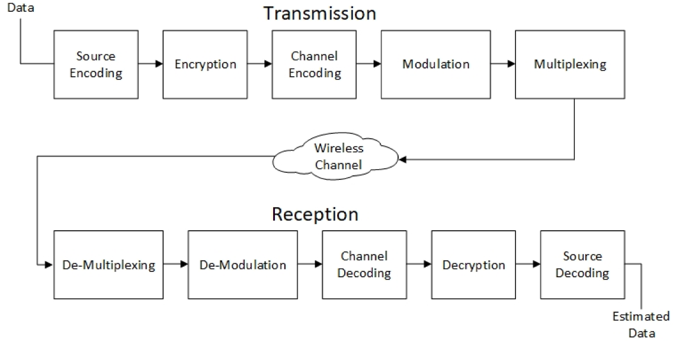
WIRELESS COMMUNICATION - BLOCK DIAGRAM

Slide 14
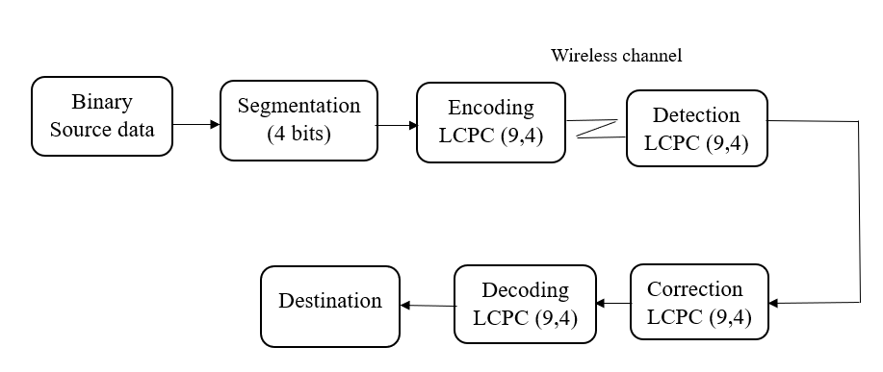
EXISTING SYSTEM
Low Complexity Parity Check (LCPC) codes.

Slide 15
CHALLENGES IN EXISTING SYSTEM
Latency and Delay Sensitivity
Area utilization on chip
High Power Consumption
Bit error rate

Slide 16
PROPOSED MINIMAL INTRICACY PARITY CHECK CODE (MIPC)
Source data
4 Bits segmentation
MIPC Encoder(9,4)
Punctured MIPC(8,4)
Channel
Output data
Message bit error detection & correction
Parity error Detection
Syndrome vector calculation
De-punctured MIPC(9,4)

Slide 17
PROPOSED MIPC ENCODER(9,4)
Start
Let the message bit be {m1,m2,m3,m4} and the parity bits be {P1,P2,P3,P4,P5}
Hence the proposed MIPC encoder has the code word be
{m1,m2,m3,m4, P1,P2,P3,P4,P5}
Received message SDi
Encode message
CDTi =SDi ×G
Stop

Slide 18
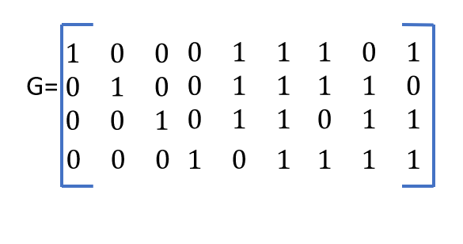

PROPOSED MIPC ENCODER(9,4)
MIPC ENCODER:
$P1=m1⨁m2⨁m3$
$P2=m1⨁m2⨁m3⊕m4$
$P3=m1⨁m2⨁m4$
$P4=m2⨁m3⨁m4$
$P5=m3⨁m1⨁m4$
m1 m2 m3 m4 P1 P2 P3 P4 P5
0 0 1 1 1 0 1 0 0
GENERATOR MATRIX:
G=[IK :P] (n,k)=(9,4)
n=codeword length
k=message length

Slide 19
PUNCTURING
Puncturing is the process of removing some of the parity bits after encoding with an error correction code
m1 | m2 | m3 | m4 | P1 | P2 | P3 | P4 | P5
0 | 0 | 0 | 0 | 0 | 0 | 0 | 0 | 0
0 | 0 | 0 | 1 | 0 | 1 | 1 | 1 | 1
0 | 0 | 1 | 0 | 1 | 1 | 0 | 1 | 1
0 | 0 | 1 | 1 | 1 | 0 | 1 | 0 | 0
0 | 1 | 0 | 0 | 1 | 1 | 1 | 1 | 0
0 | 1 | 0 | 1 | 1 | 0 | 0 | 0 | 1
0 | 1 | 1 | 0 | 0 | 0 | 1 | 0 | 1
0 | 1 | 1 | 1 | 0 | 1 | 0 | 1 | 0
1 | 0 | 0 | 0 | 1 | 1 | 1 | 0 | 1
1 | 0 | 0 | 1 | 1 | 0 | 0 | 1 | 0
1 | 0 | 1 | 0 | 0 | 0 | 1 | 1 | 0
1 | 0 | 1 | 1 | 0 | 1 | 0 | 0 | 1
1 | 1 | 0 | 0 | 0 | 0 | 0 | 1 | 1
1 | 1 | 0 | 1 | 0 | 1 | 1 | 0 | 0
1 | 1 | 1 | 0 | 1 | 1 | 0 | 0 | 0
1 | 1 | 1 | 1 | 1 | 0 | 1 | 1 | 1

Slide 20
PROPOSED DEPUNCTURING TECHNIQUE
m4 bit is retrieved using P1 and P2 parity bits
m4 | P1 | P2
0 | 0 | 0
1 | 0 | 1
0 | 1 | 1
1 | 1 | 0
0 | 1 | 1
1 | 1 | 0
0 | 0 | 0
1 | 0 | 1
0 | 1 | 1
1 | 1 | 0
0 | 0 | 0
1 | 0 | 1
0 | 0 | 0
1 | 0 | 1
0 | 1 | 1
1 | 1 | 0

Slide 21
PROPOSED MIPC DECODER
Syndrome vector calculation
Parity error detection
Message error detection and correction

Slide 22
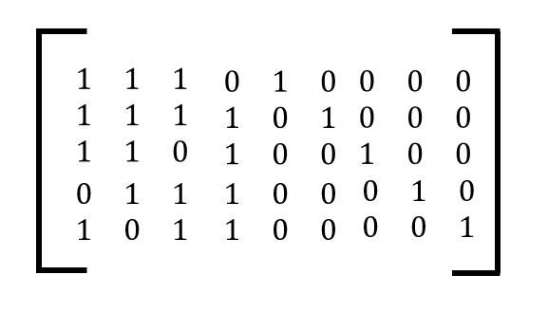
PROPOSED MIPC DECODER
SYNDROME VECTOR CALCULATION
SY=H×CD
Let the received code word be (CD1,CD2…………….CD9)
H=
Let the syndrome vector be parity of 0,1,2,3,4,5 (SY1,SY2………SY5)

Slide 23

PROPOSED MIPC DECODER
PARITY ERROR DETECTION
$$PE=\left(SY1⊙P1\right)\left(SY2⊙P2\right)\left(SY3⊙P3\right)\left(SY4⊙P4\right)\left(SY5⊙P5\right)$$
$$Where SY1=CD1⊕CD2⨁CD3$$
$SY2=CD1⊕CD2⨁CD3⊕CD4$
$$SY3=CD1⊕CD2⨁CD4$$
$$SY4=CD2⊕CD3⨁CD4$$
$$SY5=CD3⊕CD1⨁CD4$$
If PE=1, it indicates that no errors in parity bits
If PE≠1 it indicates that parity error exists. Therefore the decoder request retransmission by sending HARQ signal

Slide 24

PROPOSED MIPC DECODER
MESSAGE ERROR DETECTION AND CORRECTION
To perform single bit error detection and correction, the MIPC decoder calculates Errorcorrect1, Errorcorrect2, Errorcorrect3, Errorcorrect4:
Errorcorrect1={~CD1,CD2,CD3,CD4}*{CD5$⊕SY1\}.\{CD6⊕SY2\}.\{CD7⊕SY3\}.\{CD9⊕SY5\}+\{CD1,\sim CD2,CD3,CD4\}∗\{CD5⊕SY1\}.\{CD6⊕SY2\}.\{CD7⊕SY3\}.\{CD8⊕SY4\}+\{CD1,CD2,\sim CD3,CD4\}∗\{CD5⊕SY1\}.\{CD6⊕SY2\}.\{CD8⊕SY4\}.\{CD9⊕SY5\}+\{CD1,CD2,CD3,\sim CD4\}∗\{CD6⊕SY2\}.\{CD7⊕SY3\}.\{CD8⊕SY4\}.\{CD9⊕SY5\}$

Slide 25

CONT..
$Errorcorrect2=\overline{Errorcorrect1}∗\left\{\sim CD1,\sim CD2,CD3,CD4\right\}∗\left\{CD8⨁SY4\right\}.\left\{CD9⨁SY5\right\}+\overline{Errorcorrect1}∗\left\{\sim CD1,CD2,\sim CD3,CD4\right\}∗\left\{CD7⨁SY3\right\}.\left\{CD8⨁SY4\right\}+\overline{Errorcorrect1}∗\left\{\sim CD1,CD2,CD3,\sim CD4\right\}∗\left\{CD5⨁SY1\right\}.\left\{CD8⨁SY4\right\}+\overline{Errorcorrect1}∗\left\{CD1,\sim CD2,\sim CD3,CD4\right\}∗\left\{CD7⨁SY3\right\}.\left\{CD9⨁SY5\right\}+\overline{Errorcorrect1}∗\left\{CD1,\sim CD2,CD3,\sim CD4\right\}∗\left\{CD5⨁SY1\right\}.\left\{CD9⨁SY5\right\}+\overline{Errorcorrect1}$*$\left\{CD1,CD2,\sim CD3,\sim CD4\right\}∗\left\{CD5⨁SY1\right\}.\{CD7⨁SY3\}$

Slide 26

CONT..
$Errorcorrect3$ $=\overline{Errorcorrect2}∗\left\{\sim CD1,\sim CD2,\sim CD3,CD4\right\}∗\left\{CD5⨁SY1\right\}.\left\{CD6⨁SY2\right\}+\overline{Errorcorrect2}∗\left\{\sim CD1,\sim CD2,CD3,\sim CD4\right\}∗\left\{CD6⨁SY2\right\}.\left\{CD7⨁SY3\right\}+\overline{Errorcorrect2}∗\left\{\sim CD1,CD2,\sim CD3,\sim CD4\right\}∗\left\{CD6⨁SY2\right\}.\left\{CD9⨁SY5\right\}+\overline{Errorcorrect2}∗\left\{CD1,\sim CD2,\sim CD3,\sim CD4\right\}∗\left\{CD6⨁SY2\right\}.\left\{CD8⨁SY4\right\}$

Slide 27

CONT..
$Errorcorrect4$ $=\overline{Errorcorrect3}∗\left\{\sim CD1,\sim CD2,\sim CD3,\sim CD4\right\}∗\left\{CD5⨁SY1\right\}.\left\{CD7⨁SY3\right\}.\left\{CD8⨁SY4\right\}.\left\{CD9⨁SY5\right\}$

Slide 28
SOFTWARE REQUIRED
XILINX ISE 14.7
CADENCE 90nm
MATLAB

Slide 29
MODULE DESCRIPTION
MODULE(1) Design of MIPC encoder
MODULE (2) Puncturing
MODULE (3) De-Puncturing
MODULE (4) Design of MIPC decoder
MODULE(5) Power delay area analysis
MODULE(6) BER analysis

Slide 30
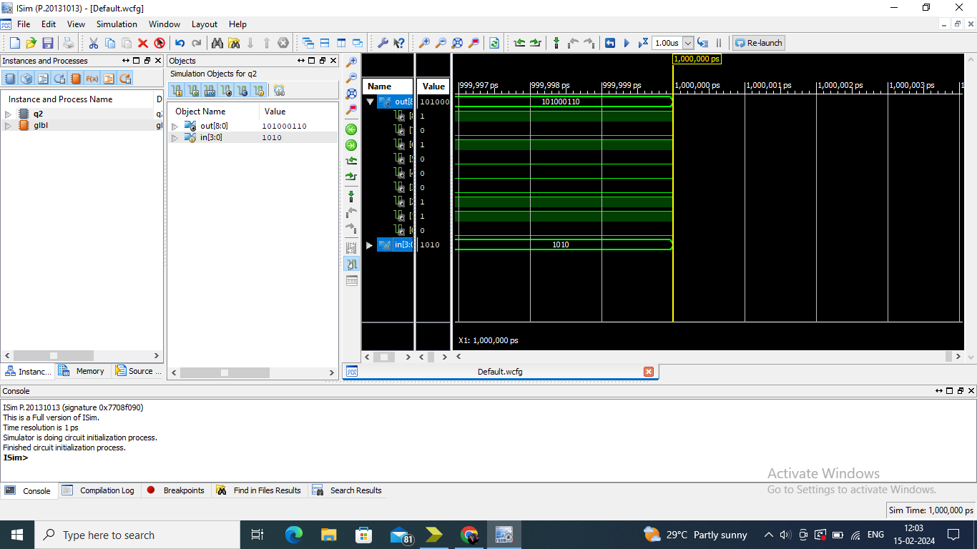
MIPC ENCODER OUTPUT

Slide 31
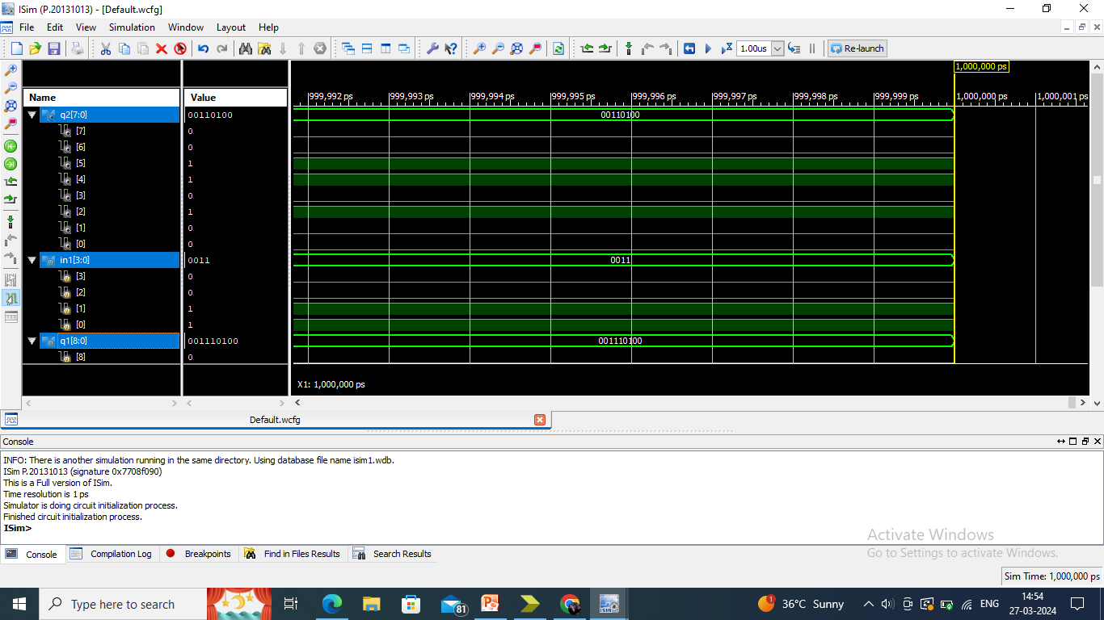
PUNCTURING

Slide 32
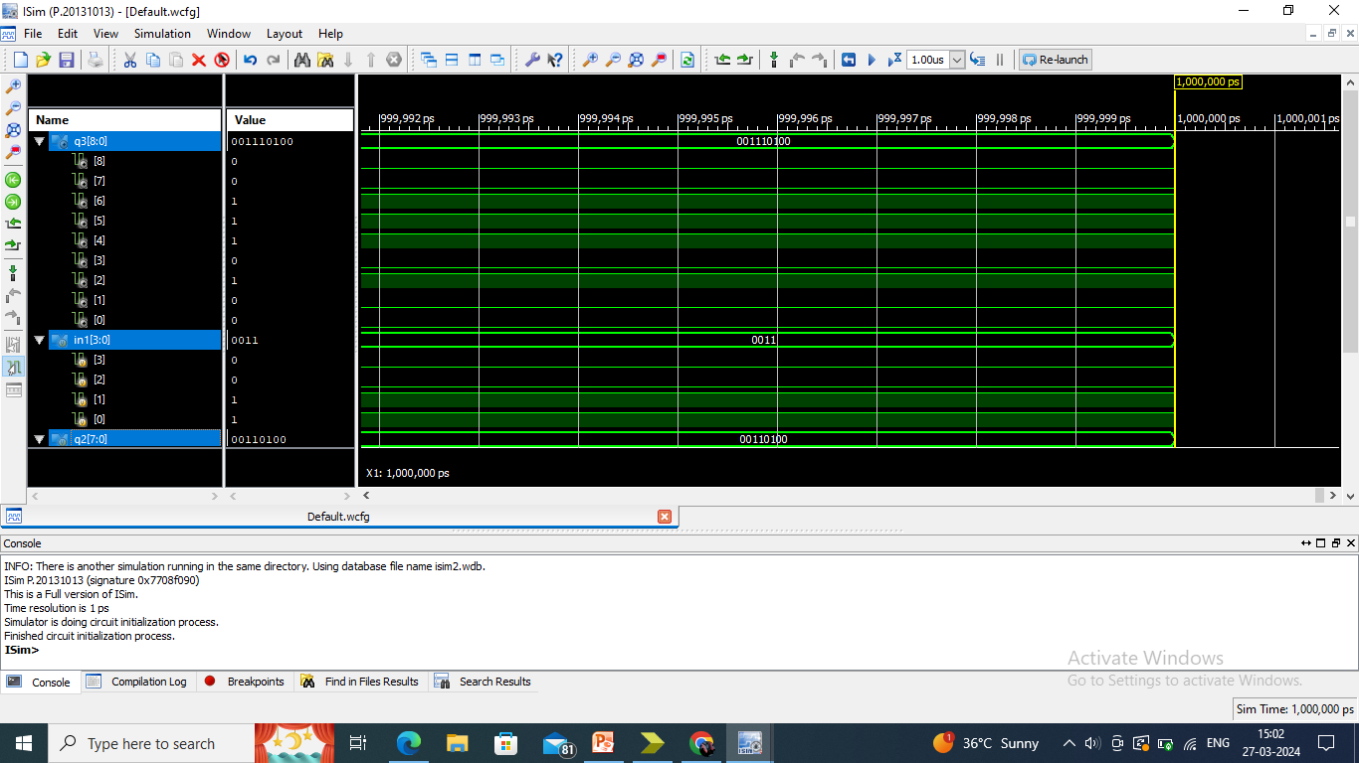
DE-PUNCTURING

Slide 33
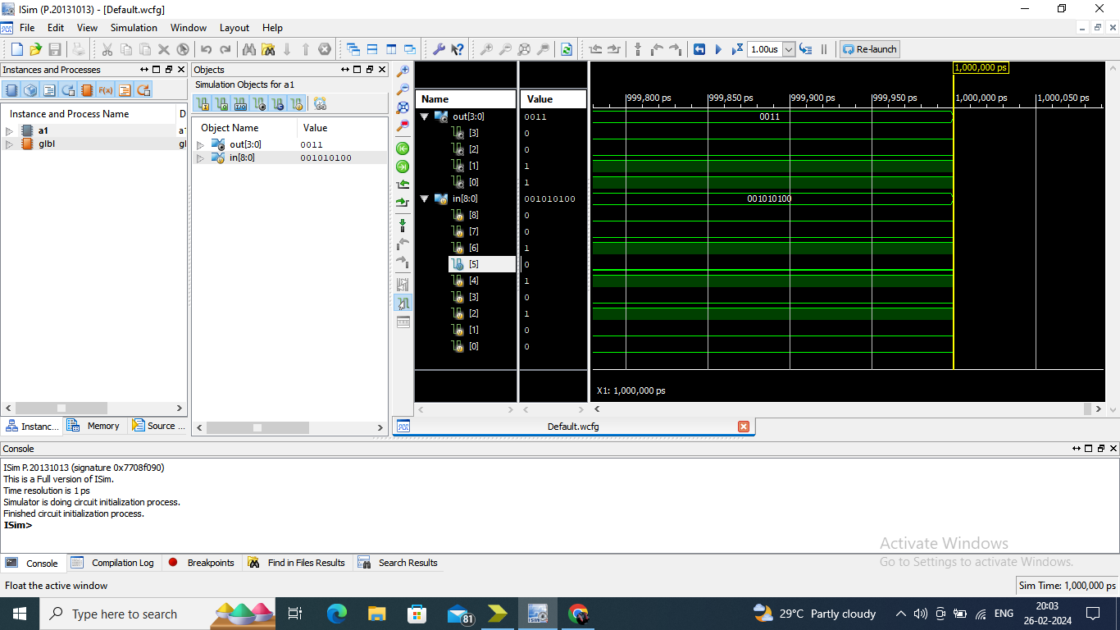
MIPC DECODER
1 BIT ERROR DETECTION AND CORRECTION

Slide 34
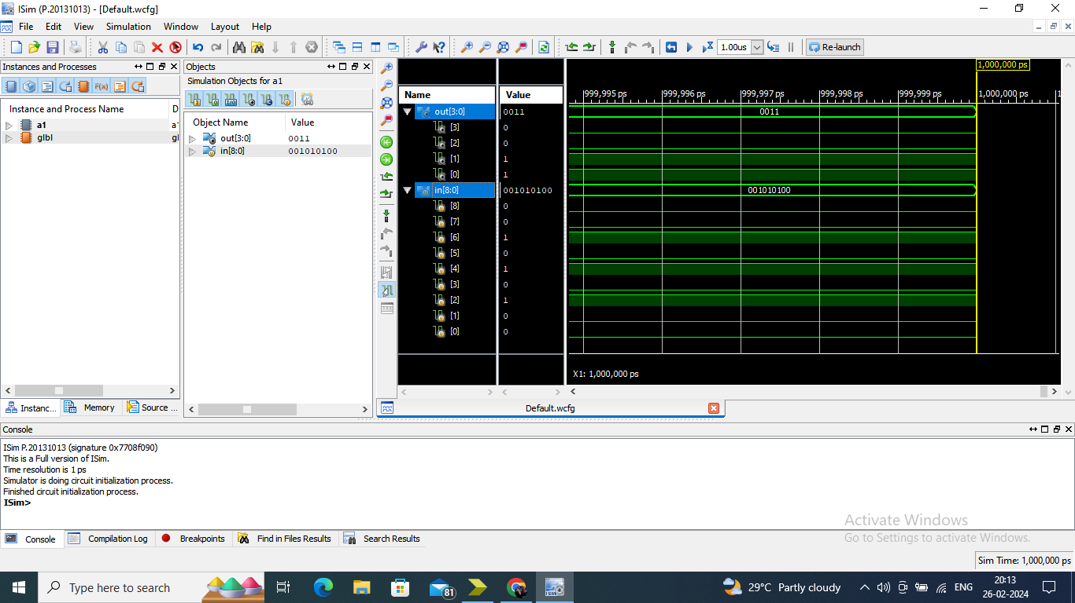
2 BIT ERROR DETECTION AND CORRECTION

Slide 35

3 BIT ERROR DETECTION AND CORRECTION

Slide 36

4 BIT ERROR DETECTION AND CORRECTION

Slide 37
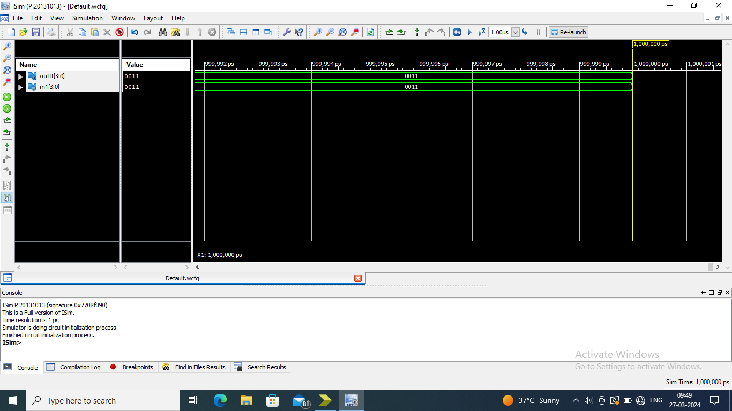
MIPC DECODER OUTPUT

Slide 38
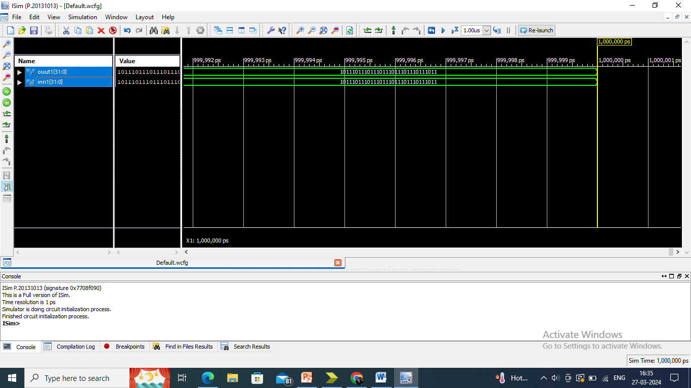
MIPC CODE (64,32) - OUTPUT

Slide 39
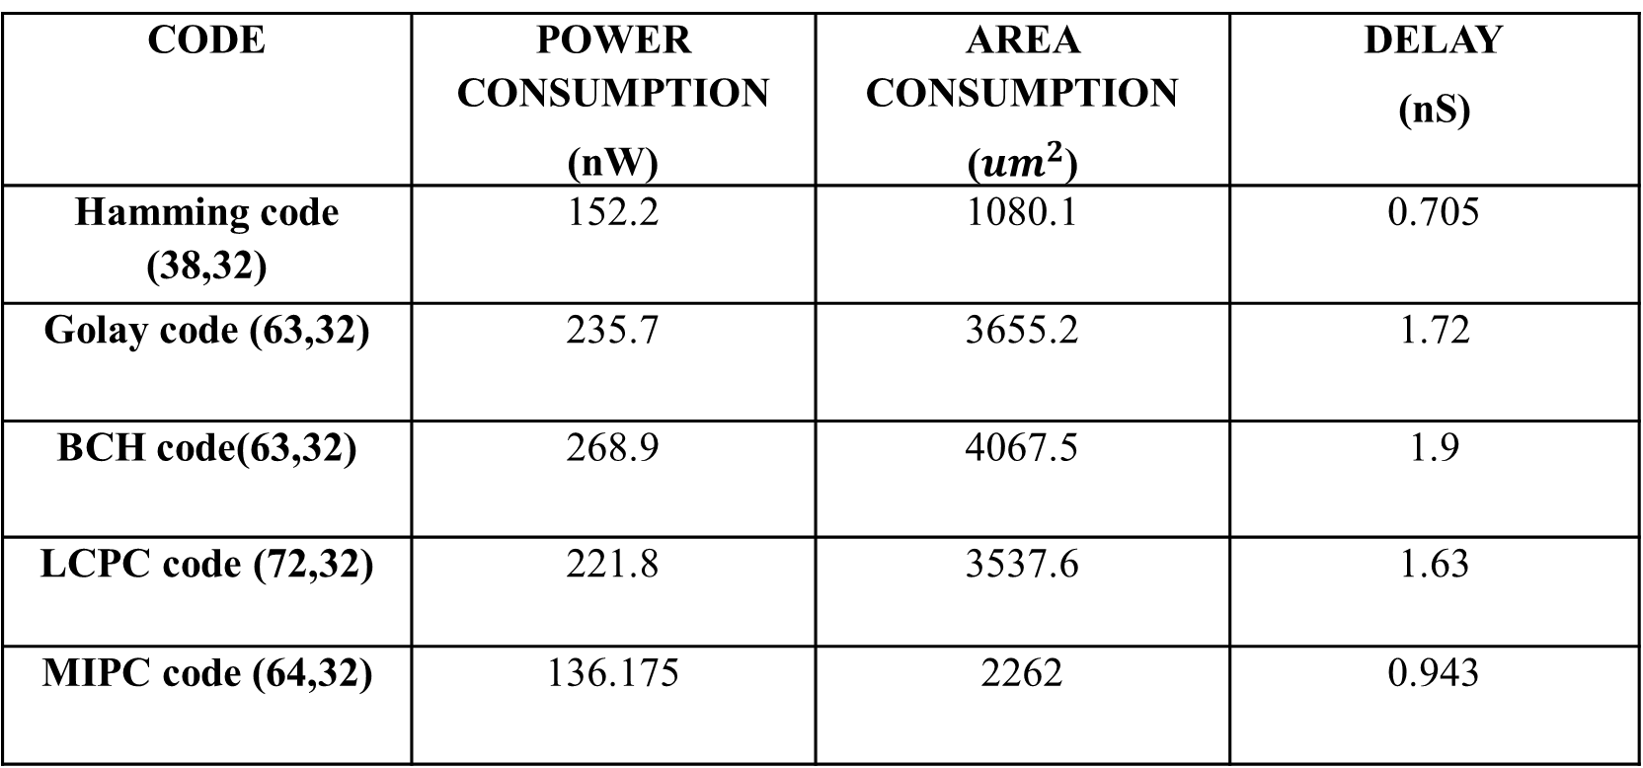
POWER, AREA AND DELAY ANALYSIS
CODE | POWER CONSUMPTION (nW) | AREA CONSUMPTION (${um}^{2}$) | DELAY (nS)
Hamming code (38,32) | 152.2 | 1080.1 | 0.705
Golay code (63,32) | 235.7 | 3655.2 | 1.72
BCH code(63,32) | 268.9 | 4067.5 | 1.9
LCPC code (72,32) | 221.8 | 3537.6 | 1.63
MIPC code (64,32) | 136.175 | 2262 | 0.943

Slide 40
POWER CONSUMPTION
(Existing System)
(Proposed System)

Slide 41
AREA CONSUMPTION
(Existing System)
(Proposed System)

Slide 42
DELAY ANALYSIS
(Existing System)
(Proposed System)

Slide 43
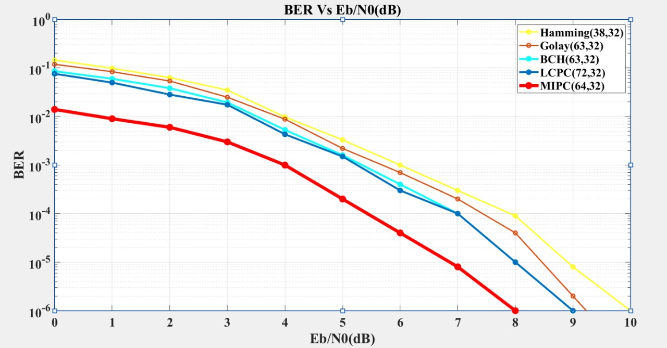
BIT ERROR RATE ANALYSIS
BER VS SNR through BPSK modulation over AWGN Channel

Slide 44
CONCLUSION
MIPC offers superior error correction with improved bit error rate making it ideal for wireless communication.
The MIPC code reduces power consumption, area usage, and delay by 38.60%, 36.06%, and 42.14% respectively, and decreases the bit error rate by 78.79% compared to the LCPC code.
The optimal decoding algorithm reduces hardware complexity in the MIPC, enabling it to detect and correct the highest number of transmission errors with fewer hardware requirements.
This project concludes that the MIPC architecture will be the suitable error correction code for next generation wireless communication.

Slide 45
FUTURE SCOPE
Implementing interleaved codes and enhancing MIPC to detect and correct parity bits can further improve Bit Error Rate.

Slide 46
REFERENCES
[1] Paterson K.G and Jones A.E 2000 Efficient decoding algorithms for generalized Reed-Muller codes. IEEE Transactions on Communications, 48(8), pp.1272-1285.
[2] Zhong H and Zhang T 2005 Block-LDPC: A practical LDPC coding system design approach. IEEE Transactions on Circuits and Systems I: Regular Papers, 52(4), pp.766-775.
[3] S. M. Elengical, F. Takawira and H. Xu, &quot;Reduced complexity maximum likelihood decoding of linear block codes,&quot; in SAIEE Africa Research Journal, vol. 97, no. 2, pp. 136-139, June 2006, doi:10.23919/SAIEE.2006.9488001

Slide 47
REFERENCES
[4] Lee C.M and Su Y.T 2009 Stochastic erasure-only list decoding algorithms for Reed-Solomon codes. IEEE Signal Processing Letters, 16(8), pp.691-694.
[5] Y. Luo and J. Li, &quot; Optimal and suboptimal structured algorithms of binary linear block codes, & quot; in Journal of Systems Engineering and Electronics, vol. 22, no. 6, pp. 1010-1014, Dec. 2011, doi: 10.3969/j.issn.1004-4132.2011.06.019.
[6] Lu E.H, Chen T.C. and Lu P.Y 2014 A new method for evaluating error magnitudes of Reed-Solomon codes. IEEE Communications Letters, 18(2), pp.340-343

Slide 48
REFERENCES
[7] Reviriego, P., Martínez, J., Pontarelli, S., et al.: ‘A method to design SEC-DED-DAEC codes with optimized decoding’, IEEE Trans. Device Mater. Reliab., 2014, 14, (3), pp. 884–889.
[8] Sarangi S and Banerjee S 2014 Efficient hardware implementation of encoder and decoder for Golay code. IEEE transactions on Very Large Scale Integration (VLSI) systems, 23(9), pp.1965-1968.
[9] Chang T.C.Y and Su Y.T 2015 Dynamic weighted bit-flipping decoding algorithms for LDPC codes. IEEE Transactions on Communications, 63(11), pp.3950-3963.

Slide 49
REFERENCES
[10] Reviriego P, Liu S, Xiao L, and Maestro J.A 2015 An efficient single and double-adjacent error correcting parallel decoder for the (24,12) extended golay code. IEEE Transactions on Very Large Scale Integration (VLSI) Systems, 24(4), pp.1603-1606.
[11] S. A. Alabady and F. Al-Turjman, &quot; Low Complexity Parity Check Code for Futuristic Wireless Networks Applications, &quot; in IEEE Access, vol. 6, pp. 18398-18407, 2018, doi:10.1109/ACCESS.2018.2818740.
[12] M. Zhang, Z. Li, L. Xing and N. Tang & quot; Construction of Some New Quantum BCH Codes, &quot; in IEEE Access, vol. 6, pp. 36122-36131,2018.

Slide 50
REFERENCES
[13] Yu N.Y 2020 Binary Golay spreading sequences and Reed-Muller codes for uplink grant-free NOMA. IEEE Transactions on Communications, 69(1), pp.276-290.
[14] B. Gong, C. Ding and C. Li, &quot;The Dual Codes of Several Classes of BCH Codes, &quot; in IEEE Transactions on Information Theory, vol. 68, no. 2,pp. 953-964, Feb. 2022

Slide 51


